Slide 1
Turning a Group into a Team

Slide 2
The Starting Point
Why I wrote a paper on teamwork,
or a Group is NOT always a Team.

Slide 3
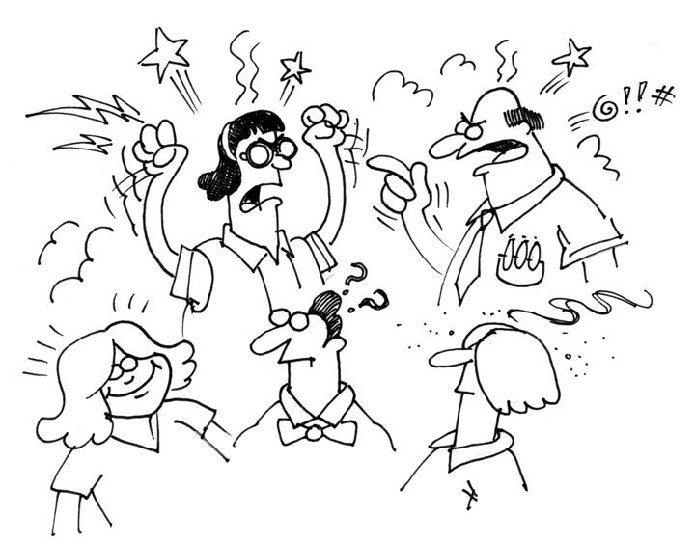
The Typical Response

Slide 4
Why Group Work?
The potential for expanded learning is so great that we have to give it a try.

Slide 5
Expectations

Slide 6
Quick & Simple
Questions and Answers
Listen/Read and Summarize
Critiques and Evaluations

Slide 7
Group Projects
The Big Commitment

Slide 8
Communication
Bonding with Group Members

Slide 9
Skills & Tasks
Developing new skills
Using existing skills
Dividing the tasks

Slide 10
Breaking Tasks Into Steps
Weekly deliverables
Time Commitments
Distributing the load

Slide 11
Redefining the Goals
Time Commitments
Distributing the load

Slide 12
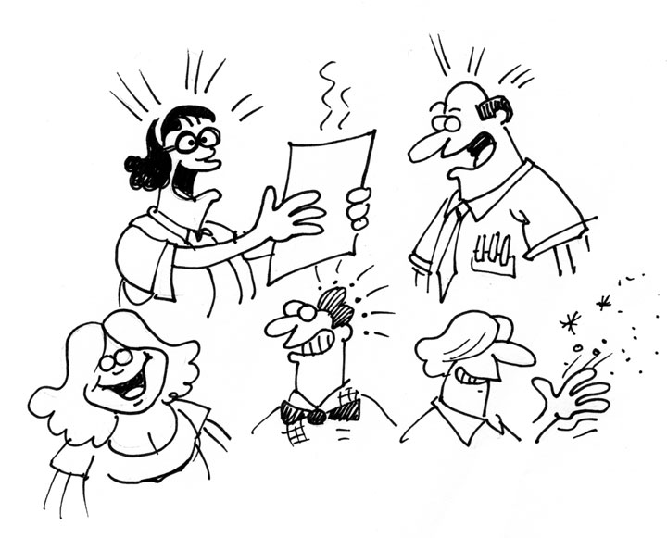
The Final Product

